Slide 1
NATRIUM SILICATUM
PETRA CIHLAROVA
www.homeopatie-praha.com

Slide 3
Natrium silicatum case
Women, 33 years old
Closed and reserved like „Nat-m“
Elegant, black eyes, sad look
Troubles begun 2 years ago, when she got devorced

Slide 4
Main physical troubles:
Started suddenly in the evening
Lower obdomen got swollen and sore
Pain expanded to back
Sharp pain as from knife, spread from stomach downwards
Worse – after eating, using antidepresive pills, sitting for longer time

Slide 5
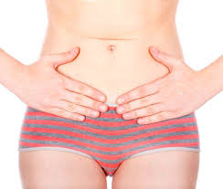
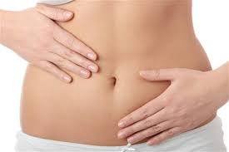
Sharp pain as from knife

Slide 6
Main physical troubles:
Frequent urge to urinate
Constipation alternated diarrhea
Painful flatulence
Pain started on the right side, now is on both sides
Pain wakes her up in night, never stops
Strong nausea, can´t eat

Slide 7
Main physical troubles:
In 2 years the pain has never stopped
A little bit better when she eats too little
Several times hospitalized
Gynecological, internal, laboratories, x-ray examinations with no results

Slide 8
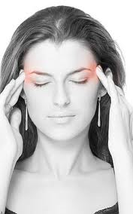
Migrains:
Started in puberty
Worse when she was
married – 3-4 days per week, now once a month
Pulling pain extending from forehead to eye and cheek
Pain started on left side, than right side
Worse as result to noise and light
Accompanied by vomiting

Slide 9
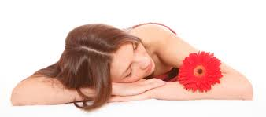
Menstruation:
Painful
Delayed 2 or 3 weeks
Cramps in lower obdomen

Slide 10
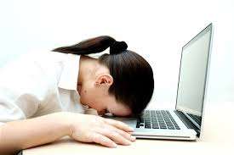
Another physical troubles:
Dry, sensitive, itching skin
Red eruption on upper part of chest
Acne on back
Red and inflamed eyes in the morning
Sleeplesness
Exhaustion

Slide 11
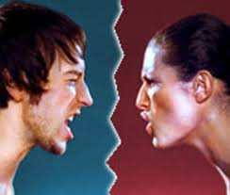
Mental state:
Awful marriage
Felt alone
Husband wasted their money, she didn´t tell it anyone
Had to devorse
Traditional catholic family and friends
Sadness, hold back her tears

Slide 12
The remedy I gave her:
Natrium muriaticum 30, 200, 1M during next 5 month
Natrium carbonicum – no result
Magnesium muriaticum – no result
Phosphoricum acidum – no result
Natrium muriaticum – seems to be quite good

Slide 13
I went back to situation, when it started:
She lived in catholic family
Nobody from her family and friends never got devorced
She had to do it just 2 years after marriage
How did she feel about it?

Slide 14
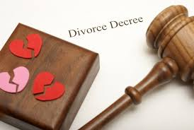
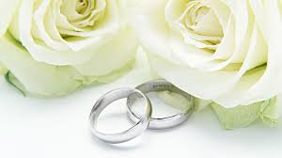
How did she feel?

Slide 15
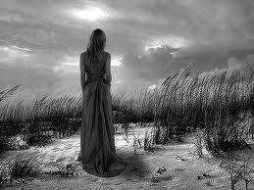
She felt:
Estranged from her family
Not belong to them
Not belong to anybody
Alone
Strong aversion to her husband

Slide 16
Repertorization:
MIND - ESTRANGED - family; from his: (31)
MIND - DELUSIONS - family, does not belong to her own: (3)
MIND - DESPAIR - love, from disappointed: (4)
MIND - DELUSIONS - alone, being - always alone; she is: (7)
MIND - DELUSIONS - alone, being - belong to anyone; she did not: (5)
MIND - AVERSION - husband, to: (18)

Slide 17
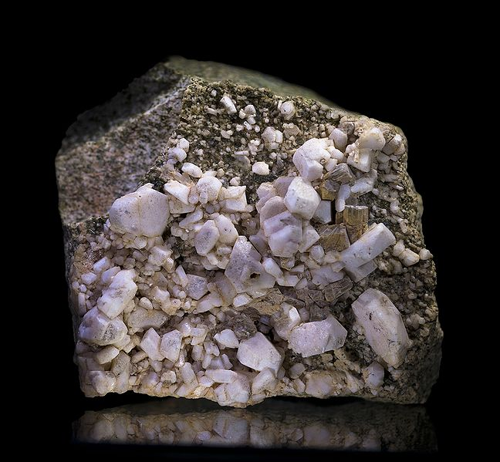
Natrium silicatum

Slide 18
Follow ups:
Natrium silicatum 200 in July 2010
August 2010: much better, looked changed, pain about 50% better
September 2010: she repeated remedy once for pain, it helps, but returned old thoughts : Natrium silicatum 1M
Actouber 2010: no pain, sleep well, energy enough, good mood
April 2011: give thanks ☺

Slide 19
Follow up April 2011

Slide 20
Natrium silicatum - mind
Feeling being alone, not belong to the group, even to her family, estranged
Deep sadness, prolong grieve, despair
Confusion about his feelings
Irresolution, indifference, laziness
Fears – failure, people, crowd, dark, disease, death, alone
Aversion certain persons, husband
Amel. – dancing, physical exertion, music

Slide 21
Natrium silicatum - physical
Headache, migrains
Weakness
Poor digestion
Cramps after eating
Stitching pain in abdomen
Sleeplesness – cares, thoughts activity
Pain – back, extremities, menses

Slide 22
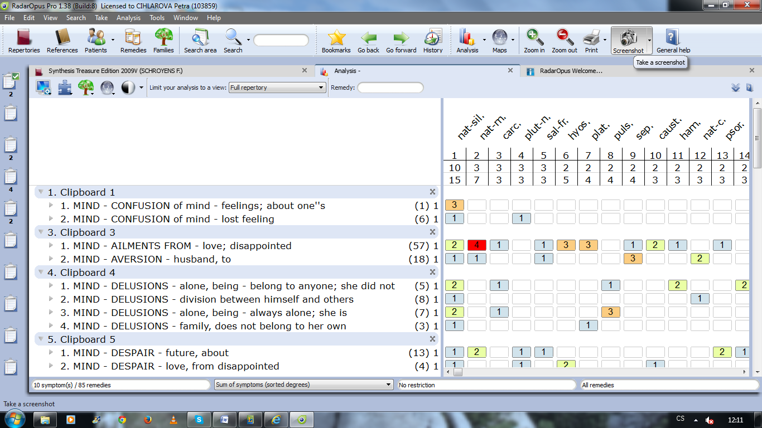
Natrium silicatum – the remedy for devorse?

Slide 23
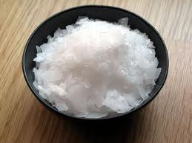
Differential diagnosis
Natrium muriaticum
Ailments from disappointed love
Closed, reserved
Aversion to husband
Desair from future
Grieve - prolong, silent

Slide 24
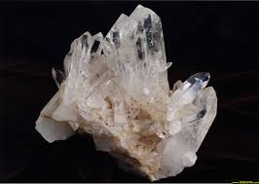
Differential diagnosis
Silicea
Fear of failure ine examination
Desire for sunshine
Irresolution
Pedant

Slide 25
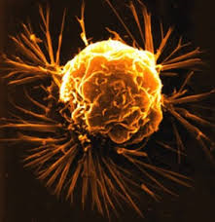
Differential diagnosis
Carcinosin
Chronic sadness
Feeling being alone
Pedant

Slide 26
Are for you, Homeopaths, various level of healing?
For me, as homeopath, there are practically many levels of healing, but just one right way to help my patiens. It depents on how deep I´m able to go to the story of patient and how similar is the remedy which I give them.

Slide 27
If so, which once?
If we give the remedy, usually something happens. We can call it levels of healing, but for me it is the way how to find the simillimum. I think, that in our practice there are just seldom cases in which we can say: „Yes, this is the simillimum!“ and the patient is happy for many years on one remedy. Usually we have to change the remedy more often. And the question is Why? May be our knowledge is not good enough to find the simillimum, or all world is changing so our patient and his remedy is changing, too, or there are various levels of healing and we can see just what is floating on the surface.

Slide 28
Which strategies are you applying in your practice?
When I start to treat the patient, I always give the best remedy which I can, but not always I´m able to reach a goal and choose the right remedy which the patient needs. We can call it levels of healing or the path how to find the right remedy and reach the goal.
In my practice I´m applying the simple strategy: Carefuly listen the patient, take the centre line of his story and choose the best remedy which I can. And see what happen and react on it.

Slide 29
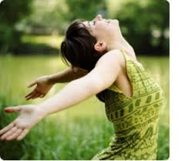
Homeopathy can
Free people from:
- Fears
- Pain
- Disease
Change point of view
We can change the world. Let‘s do it!

Slide 30
Sources of the pictures
https://www.google.cz/search?hl=cs&site=imghp&tbm=isch&source=hp&biw=1366&bih=641&q=bolest&oq=bolest&gs_l=img.3..0l10.1290.2136.0.3465.6.6.0.0.0.0.356.1360.0j3j2j1.6.0....0...1ac.1.45.img..3.3.492.aoMxDMWvbig
://www.google.cz/search?hl=cs&site=imghp&tbm=isch&source=hp&biw=1366&bih=641&q=bolest&oq=bolest&gs_l=img.3..0l10.1290.2136.0.3465.6.6.0.0.0.0.356.1360.0j3j2j1.6.0....0...1ac.1.45.img..3.3.492.aoMxDMWvbig#hl=cs&q=radost&tbm=isch&facrc=_&imgdii=_&imgrc=zMD5MZf14a9CqM%253A%3Bi9plmrzp1vWFXM%3Bhttp%253A%252F%252Fjenprokrasu.jenprozeny.cz%252Fsites%252Fdefault%252Ffiles%252Fimagecache%252Fupoutavka%252Fteasers%252F5564%252F38839.jpg%3Bhttp%253A%252F%252Fjenprokrasu.cz%252Fzdravi%252F5564-recept-na-radost-budte-si-vdecna%3B426%3B344
https://www.google.cz/search?hl=cs&site=imghp&tbm=isch&source=hp&biw=1366&bih=641&q=bolest&oq=bolest&gs_l=img.3..0l10.1290.2136.0.3465.6.6.0.0.0.0.356.1360.0j3j2j1.6.0....0...1ac.1.45.img..3.3.492.aoMxDMWvbig#hl=cs&q=svatba&tbm=isch&facr
ttps://www.google.cz/search?hl=cs&site=imghp&tbm=isch&source=hp&biw=1366&bih=641&q=bolest&oq=bolest&gs_l=img.3..0l10.1290.2136.0.3465.6.6.0.0.0.0.356.1360.0j3j2j1.6.0....0...1ac.1.45.img..3.3.492.aoMxDMWvbig#hl=cs&q=rozvod&tbm=isch&facrc=_&imgdii=_&imgrc=hh1Zs8_kCggbQM%253A%3BXNr9KNeJQvI1iM%3Bhttp%253A%252F%252Fimg.diva.sk%252Fstories%252F2013%252Fvztahy%252Fostatne%252Frozvod-rozchod-sud-koniec-laska_dreamstime.com.jpg%3Bhttp%253A%252F%252Fdiva.aktuality.sk%252Fclanok%252F36688%252Fpravnik-ponuka-bezplatny-rozvod-ako-valentinsky-darcek%252F%3B700%3B469
https://www.google.cz/search?hl=cs&site=imghp&tbm=isch&source=hp&biw=1366&bih=641&q=bolest&oq=bolest&gs_l=img.3..0l10.1290.2136.0.3465.6.6.0.0.0.0.356.1360.0j3j2j1.6.0....0...1ac.1.45.img..3.3.492.aoMxDMWvbig#hl=cs&q=migr%C3%A9na&tbm=isch&facrc=_&imgdii=_&imgrc=8p-d6sKsYZTNTM%253A%3BHDYfGSRy9T_TYM%3Bhttp%253A%252F%252Fimg.diva.sk%252Fstories%252FZdravie%252Fmigrena_druha_4.jpg%3Bhttp%253A%252F%252Fdiva.aktuality.sk%252Fclanok%252F37250%252Fstrasiak-menom-migrena-10-tipov-ako-ju-porazit%252F%3B250%3B400
g.3..0l10.1290.2136.0.3465.6.6.0.0.0.0.356.1360.0j3j2j1.6.0....0...1ac.1.45.img..3.3.492.aoMxDMWvbig#hl=cs&q=natrium+silicatum&tbm=isch&facrc=_&imgdii=_&imgrc=VDFd5GtKbRoOhM%253A%3BzFQoDt-9nDWm0M%3Bhttp%253A%252F%252Fwww.interhomeopathy.org%252Fassets%252Fimages%252F001307%252F648px-Albite2.jpg%3Bhttp%253A%252F%252Fwww.interhomeopathy.org%252Fnatrium-silicatum-collapse-of-relationships%3B648%3B599
https://www.google.cz/search?hl=cs&site=imghp&tbm=isch&source=hp&biw=1366&bih=641&q=bolest&oq=bolest&gs_l=img.3..0l10.1290.2136.0.3465.6.6.0.0.0.0.356.1360.0j3j2j1.6.0....0...1ac.1.45.img..3.3.492.aoMxDMWvbig#hl=cs&q=natrium+silicatum&tbm=isch&facrc=_&imgdii=_&imgrc=Wyk6hscS4EFH_M%253A%3BzFQoDt-9nDWm0M%3Bhttp%253A%252F%252Fwww.interhomeopathy.org%252Fassets%252Fimages%252F001307%252F800px-DuneBlanche.jpg%3Bhttp%253A%252F%252Fwww.interhomeopathy.org%252Fnatrium-silicatum-collapse-of-relationships%3B800%3B600

Slide 31
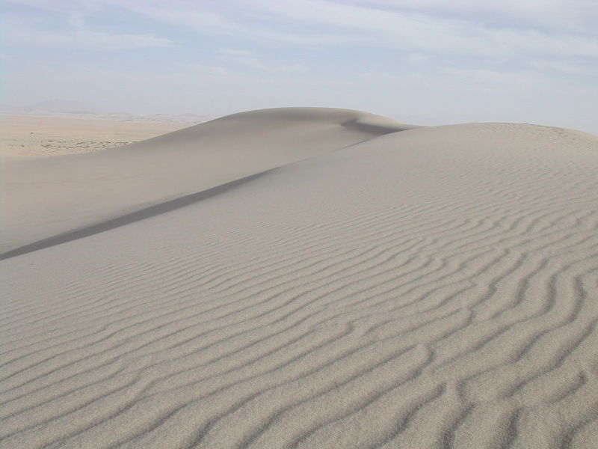
Thank you for your attention

